Slide 1

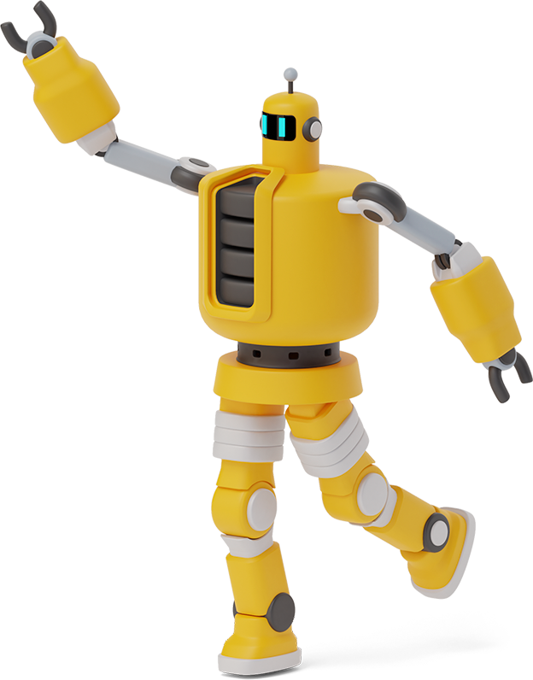
Basic chatbot
With Tkinter
“Winning Camp Mini Project”
Submitted By: Deepak Singh Rana

Slide 2

chatbot:
Computer program designed to simulate conversation with human users.
Project Descriptions:
It is a chatbot machine that is based on specific rules to answer the text given by humans. The generated response by this chatbot is near accurate because of the rule it imposed; however, if we were given a query that did not match the rule, the chatbot would not answer it.

Slide 3
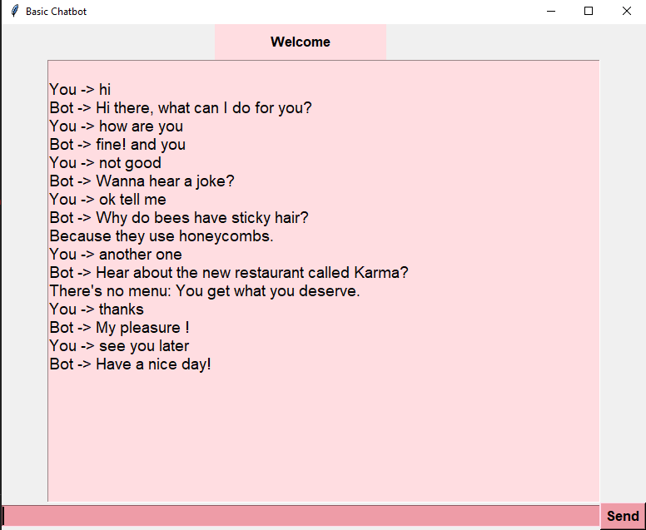
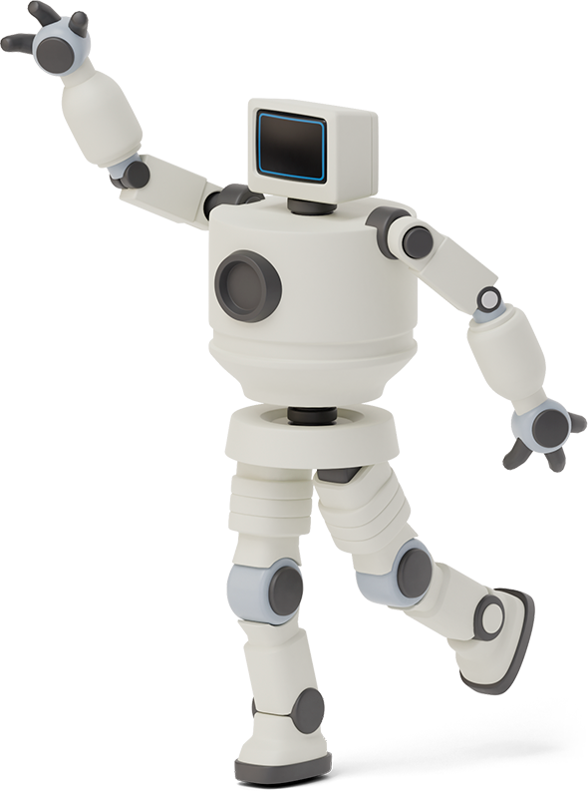
Ui of project
Here is the example of chats that we can have with our bot.

Slide 4

About the Ui :
Tkinter is the Python interface to Tk, which is the GUI toolkit for Tcl/Tk.
Tcl (pronounced as tickle) is a scripting language often used in testing, prototyping, and GUI development. Tk is an open-source, cross-platform widget toolkit used by many different programming languages to build GUI programs.
Python implements the Tkinter as a module. Tkinter is a wrapper of C extensions that use Tcl/Tk libraries.

Slide 5
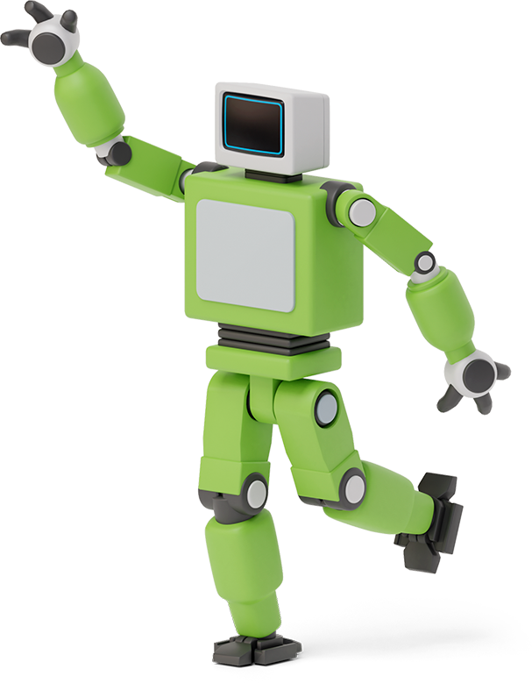
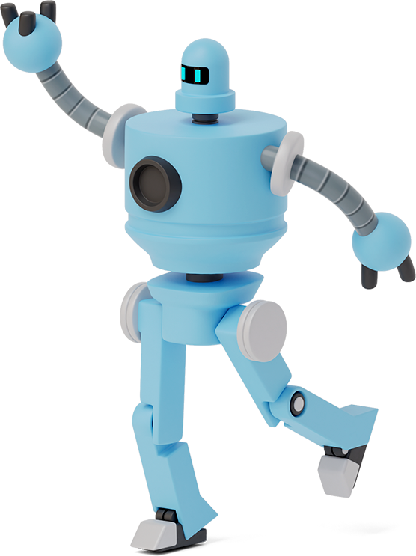

Advantages of Tkinter:
Tkinter allows you to develop desktop applications. It’s a very good tool for GUI programming in Python.
Tkinter is a good choice because of the following reasons:
Easy to learn.
Use very little code to make a functional desktop application.
Layered design.
Portable across all operating systems including Windows, macOS, and Linux.
Pre-installed with the standard Python library.

Slide 6
Future Scopes:
Task-oriented (declarative) chatbot.
Data-driven and predictive (conversational) chatbot.
Use of rules, NLP, and ML in chatbot.
Voice Bots.

Slide 7
Thanks!
Any questions?

